Slide 1
Write to market masterclass
Chris fox presents

Slide 2
Something to take notes with

Slide 3
A smartphone or tablet

Slide 4
Download this presentation:
chrisfoxwrites.com/pnwa

Slide 5
So who is
Chris fox?

Slide 6
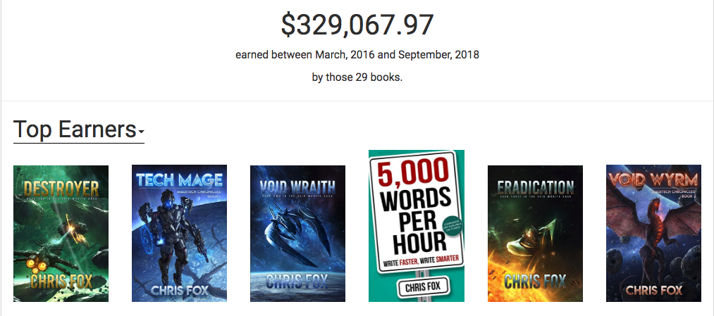
My Qualifications

Slide 7
My first story

Slide 8
Enter the real world

Slide 9
I quit

Slide 10
The Rifter

Slide 11
Gordan Gecko

Slide 12
Lester burnham

Slide 13
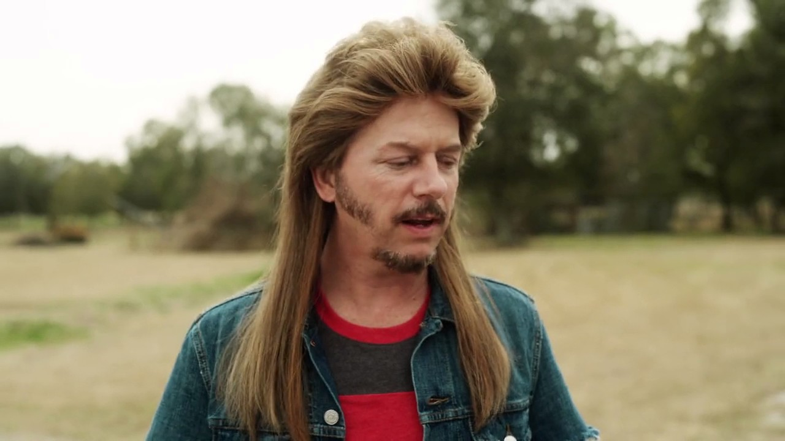
Bad country song

Slide 14
Shawshank Redemption

Slide 15
Toastmasters

Slide 16
Making my own luck

Slide 17
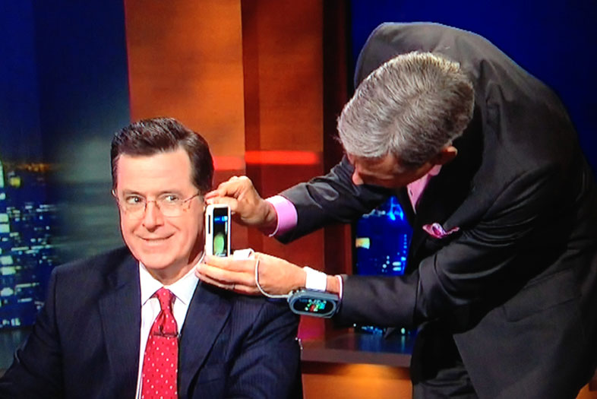
Right Place, Right Time

Slide 18
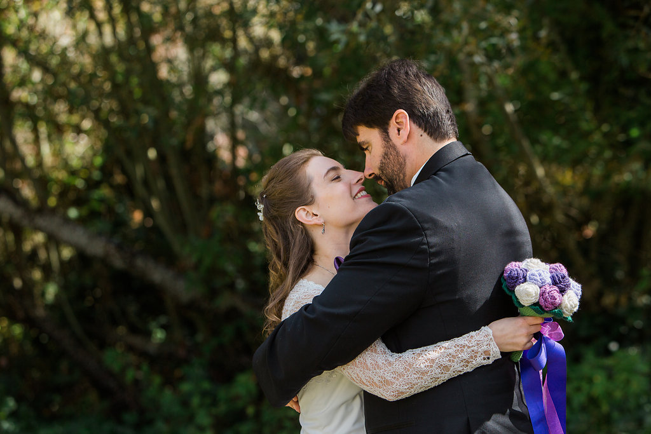
Impress a girl

Slide 19
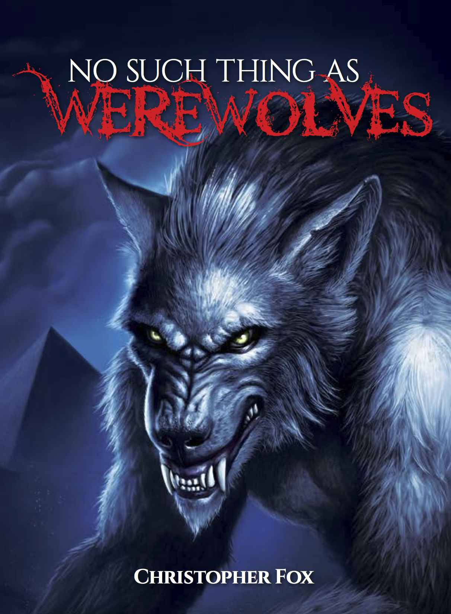
My first novel

Slide 20
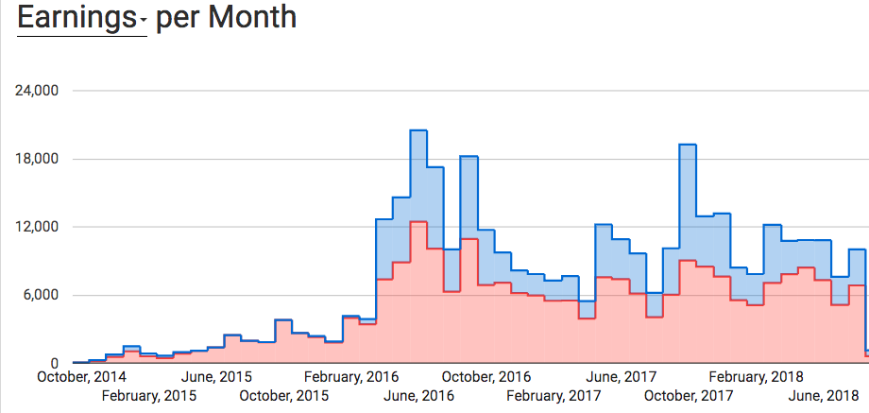
Guess when I started writing to market?

Slide 21
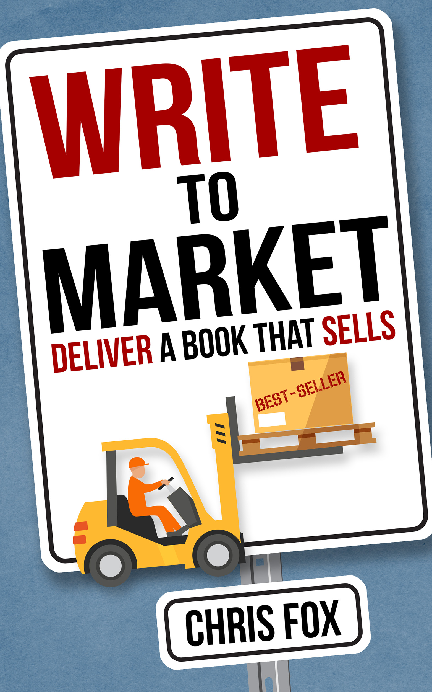
What is writing to market?
Part one

Slide 22
Tenant #1-
identify your audience
before you start writing

Slide 23
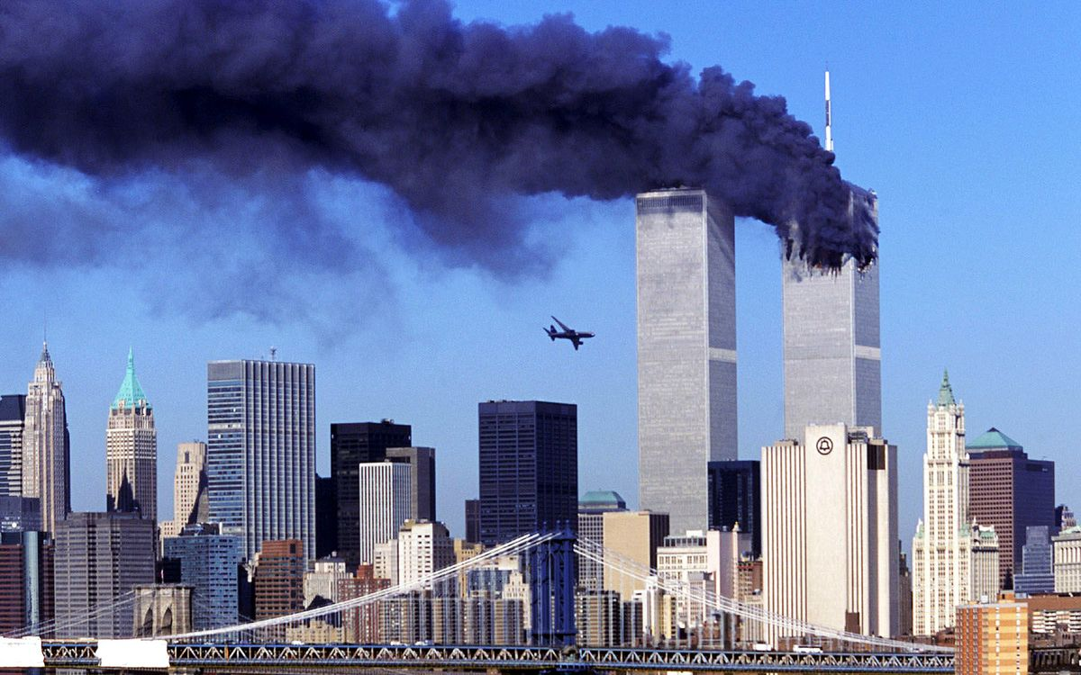
How old is your audience?

Slide 24
Tenant #2-
understand emotional resonance

Slide 25

Tenant #3-
Write what you love

Slide 26
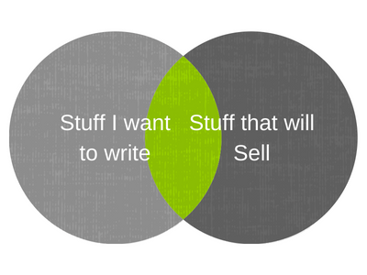
Find your sweet spot

Slide 27
What genres
do you want to write to market?

Slide 28

How do I know it works?

Slide 29
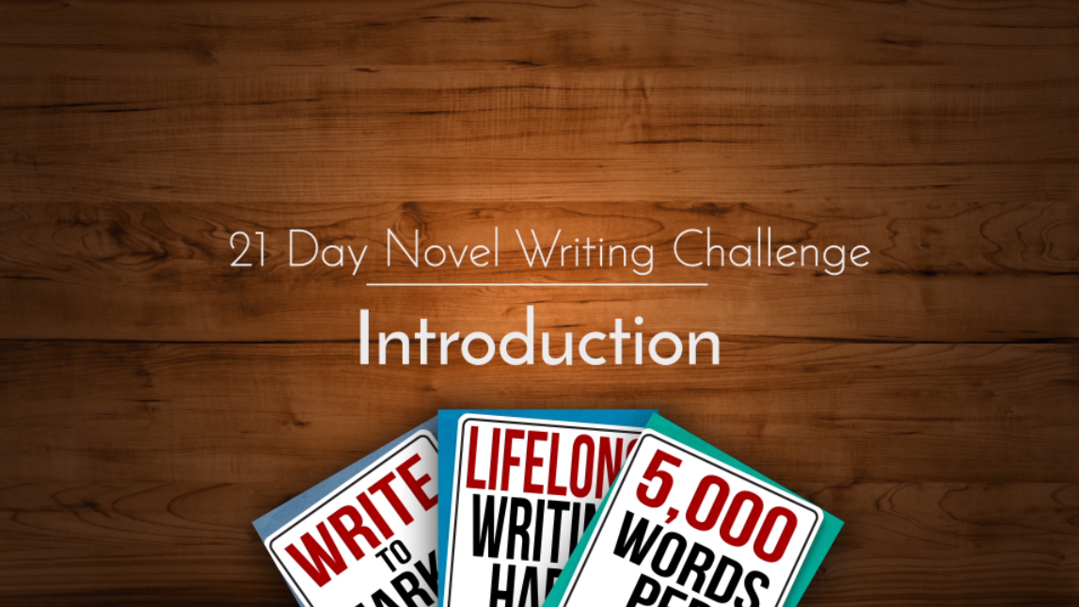
21 Day Novel Challenge

Slide 30
Spoilers
It worked

Slide 31
But Why
did it work?

Slide 32
Because I did
everything right

Slide 33
…not initially mind you

Slide 34
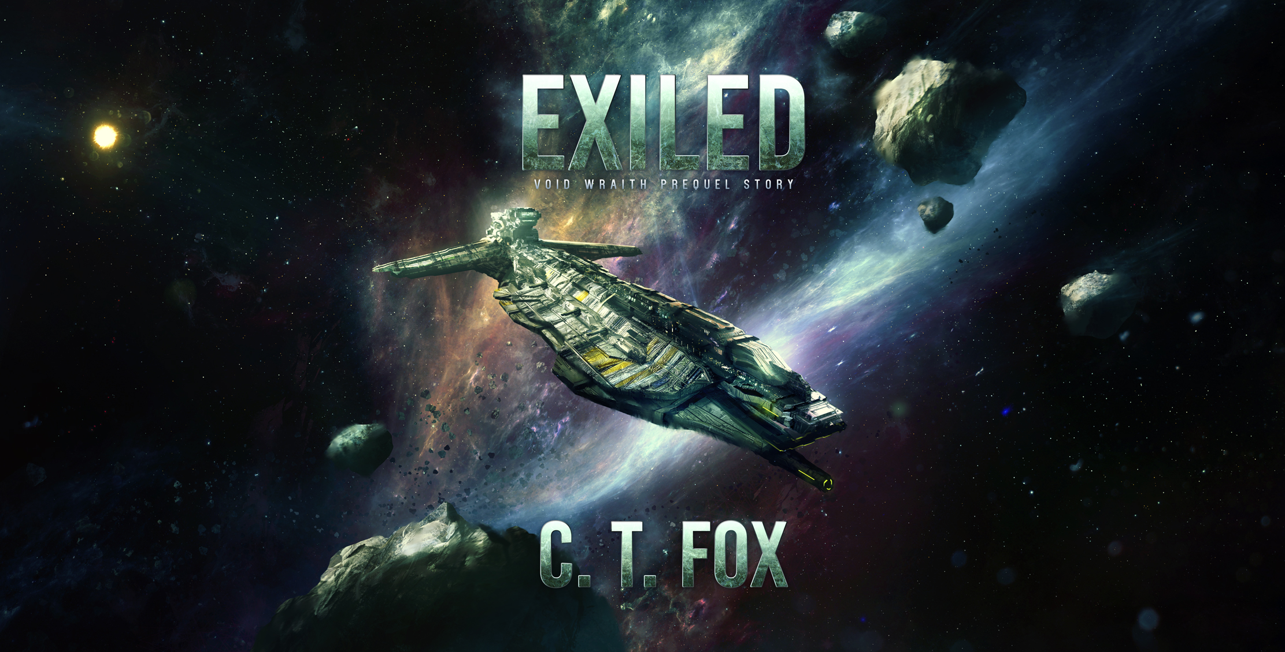
Initial cover art

Slide 35
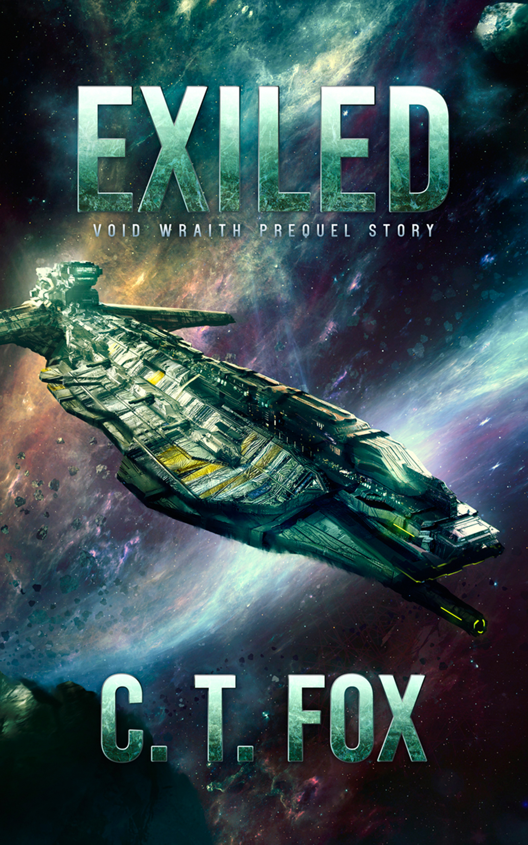
What readers see

Slide 36
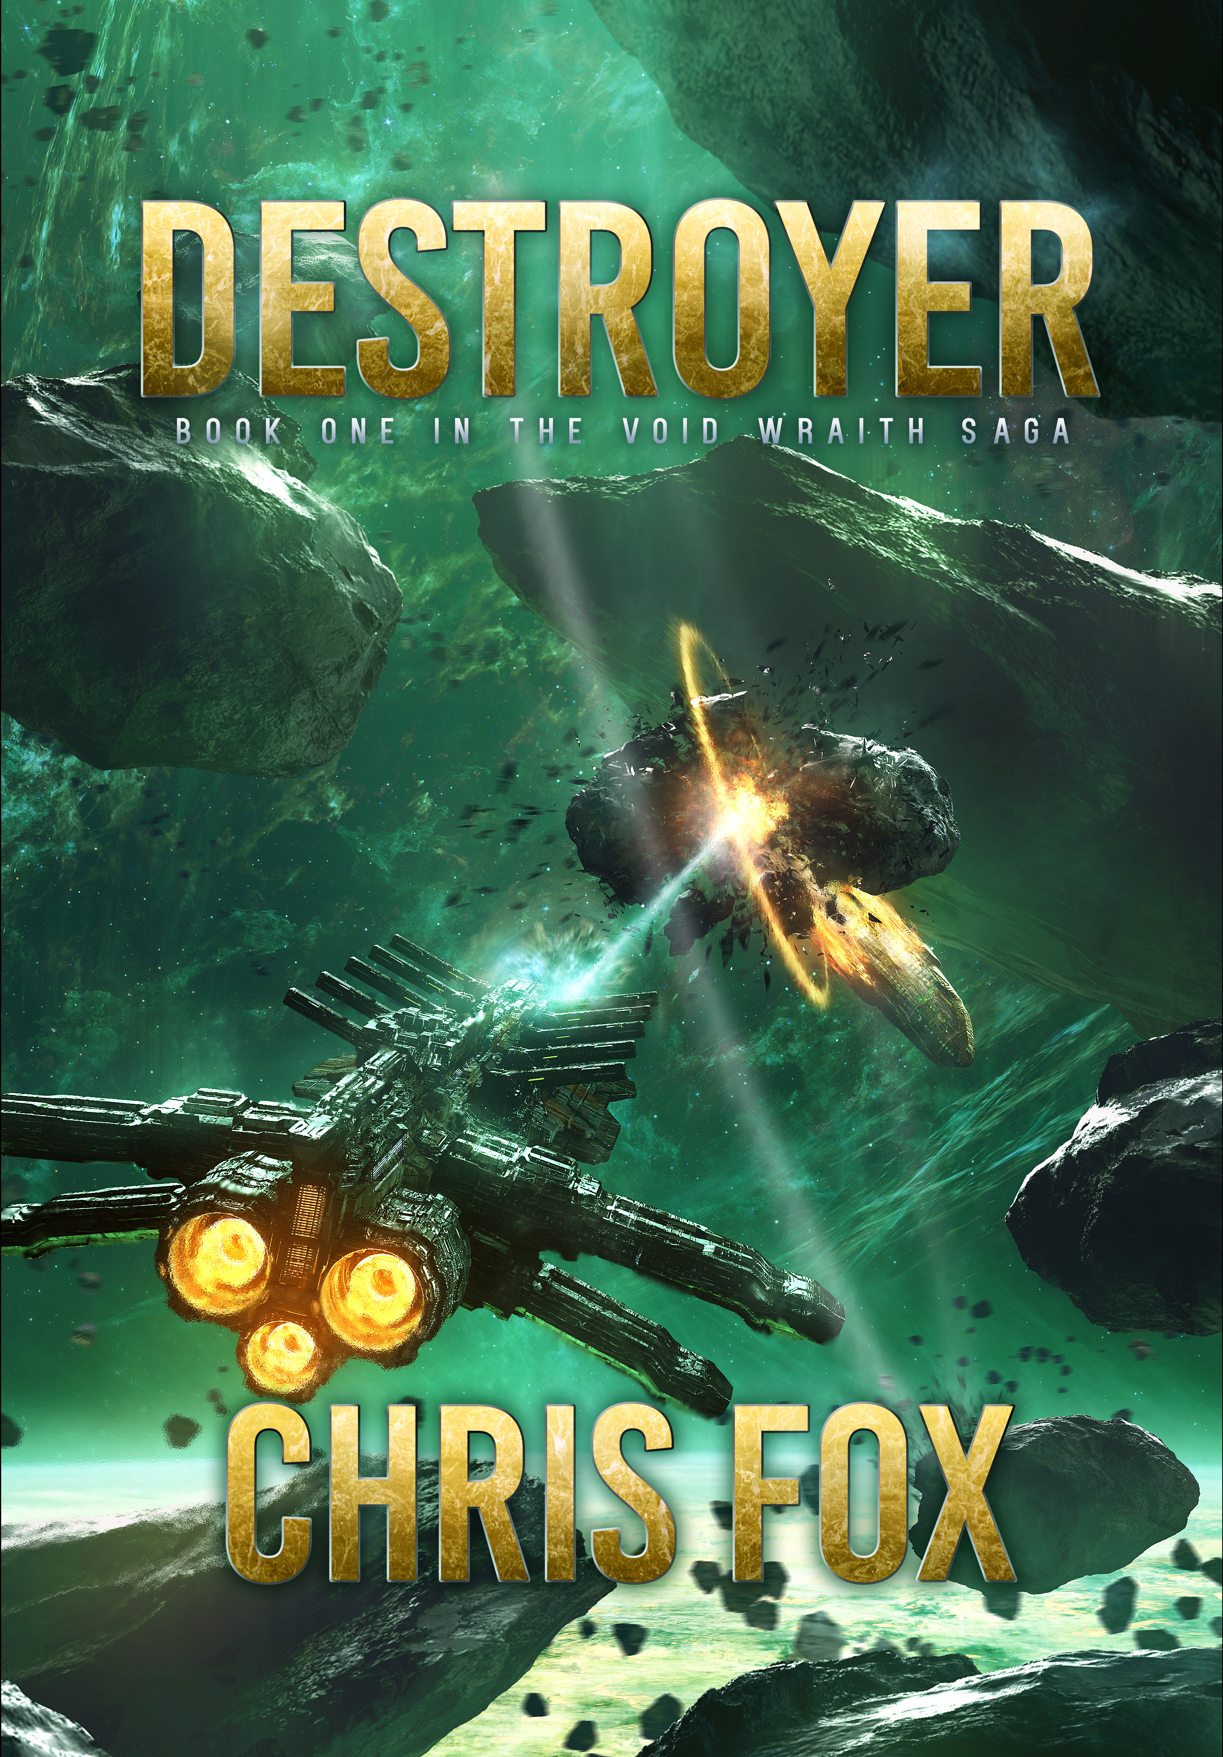
The Resulting Novel

Slide 37
Writing to Market
vs
writing to trend

Slide 38
Writing to trend

Slide 39
Are you
selling out?

Slide 40
Questions so far?

Slide 41
Researching your market
Part two

Slide 42
Become your
target reader

Slide 43
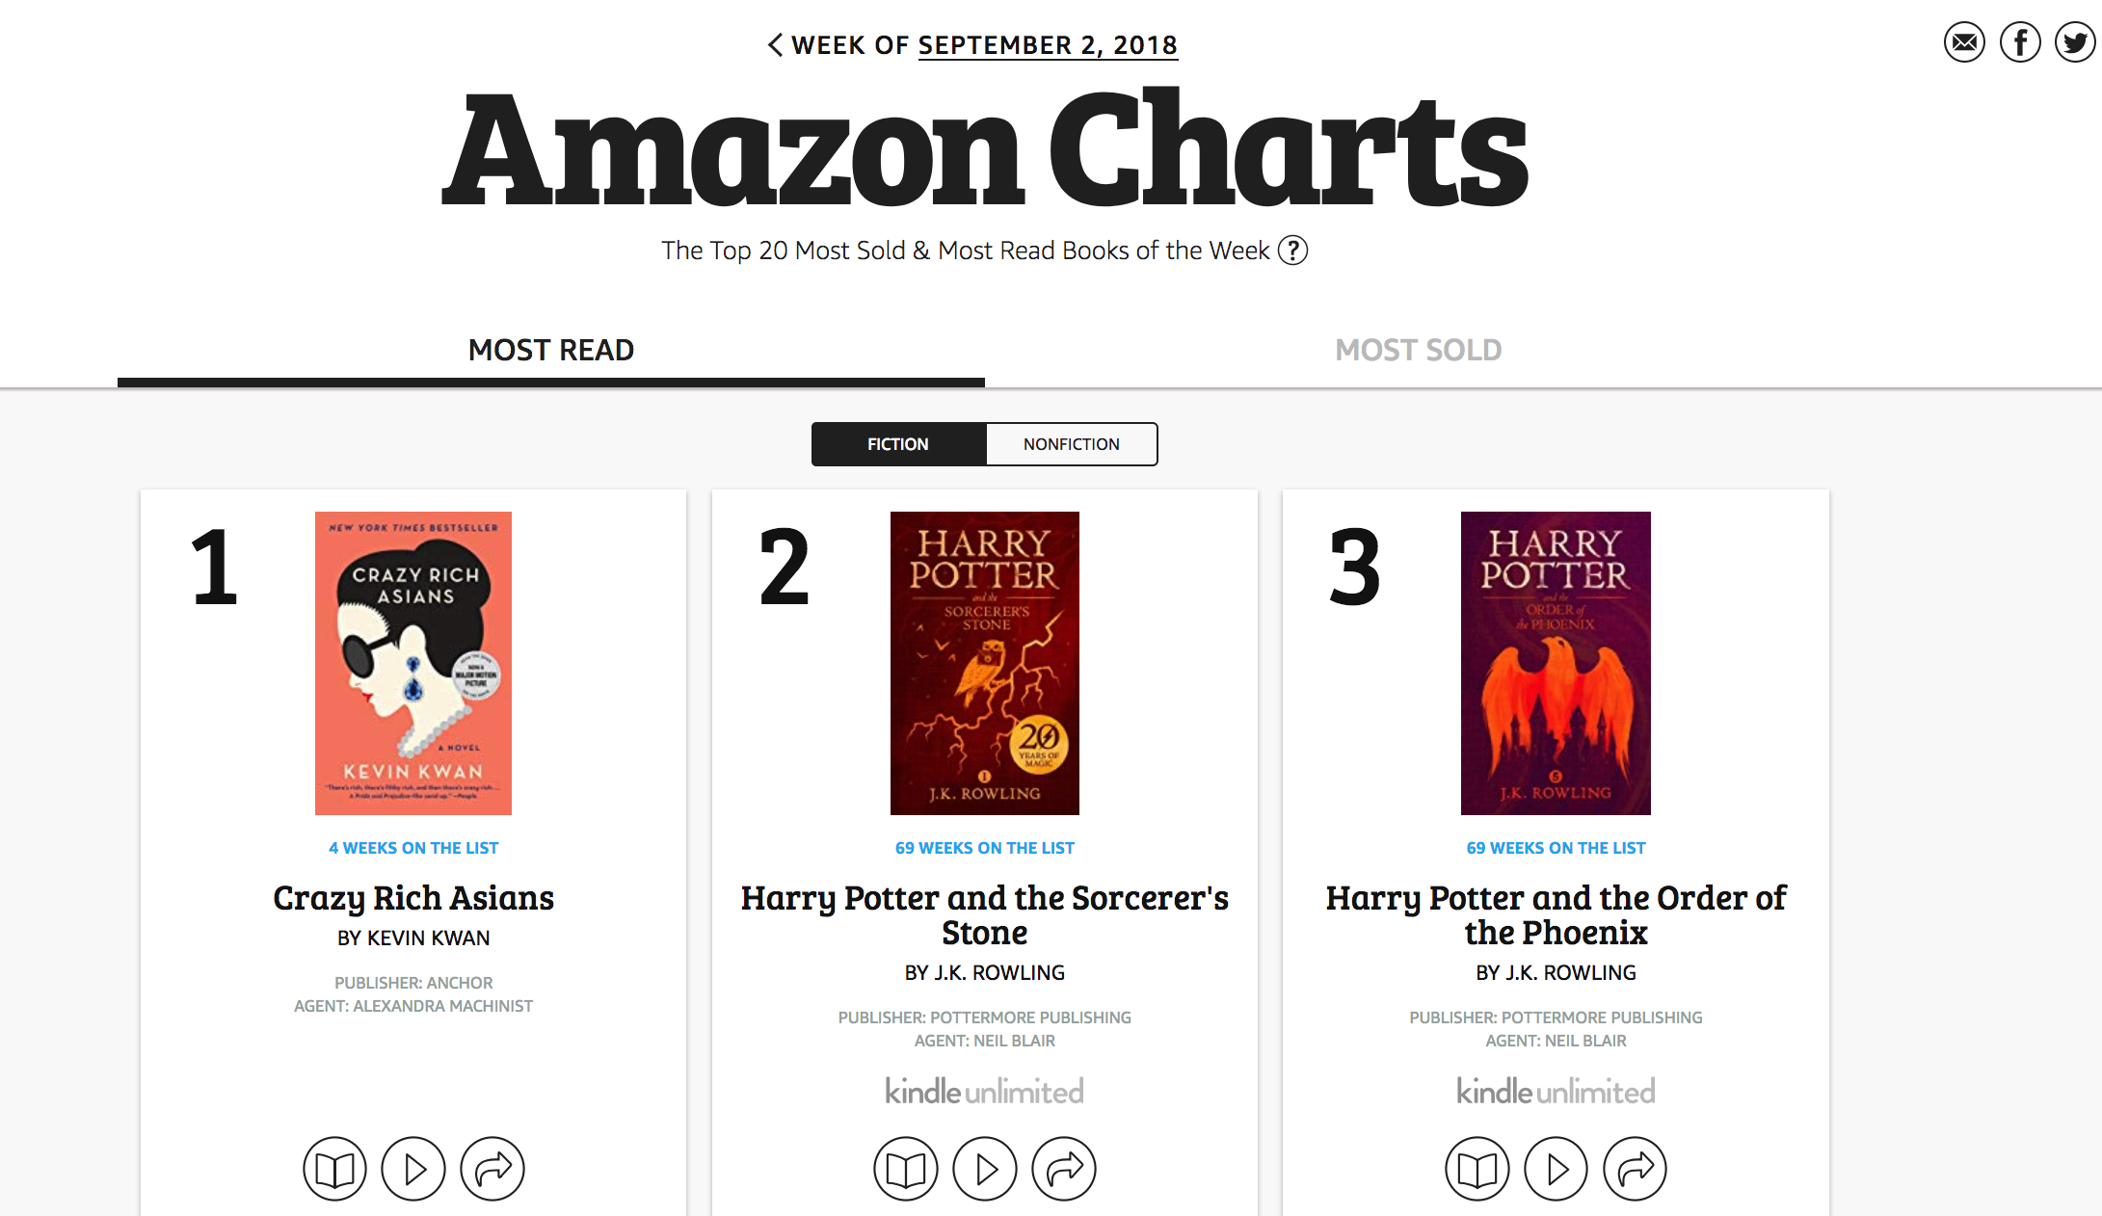
Studying Amazon Charts

Slide 44
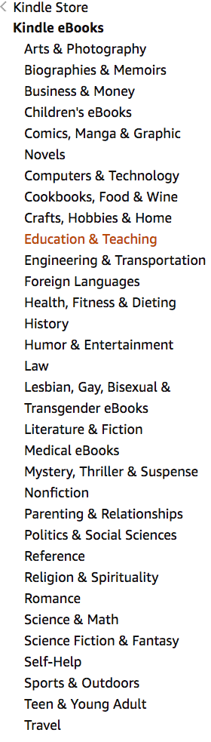
Browsing categories

Slide 45
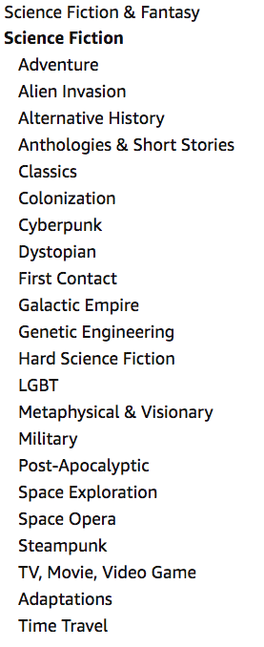
Subcategories

Slide 46
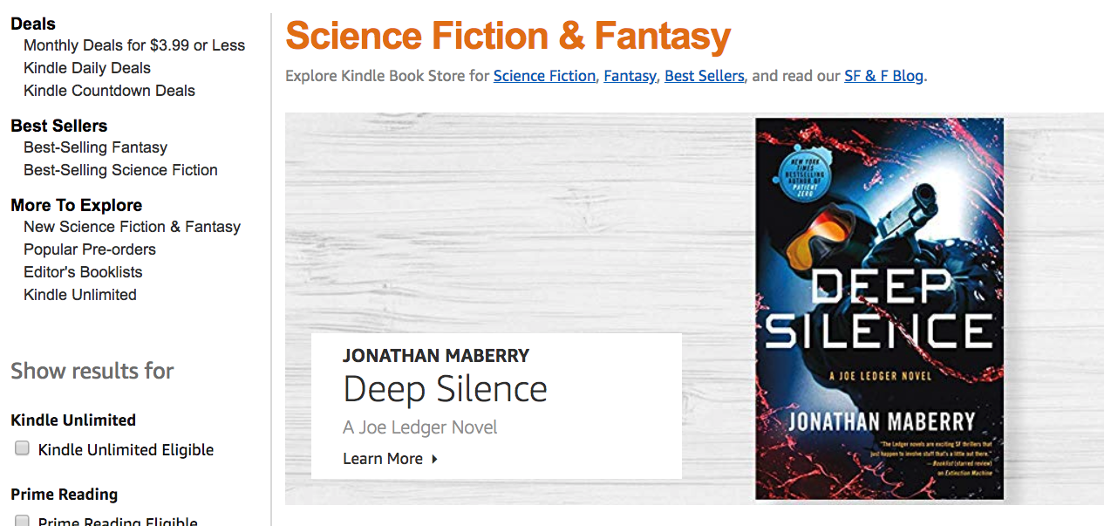
Genre page

Slide 47
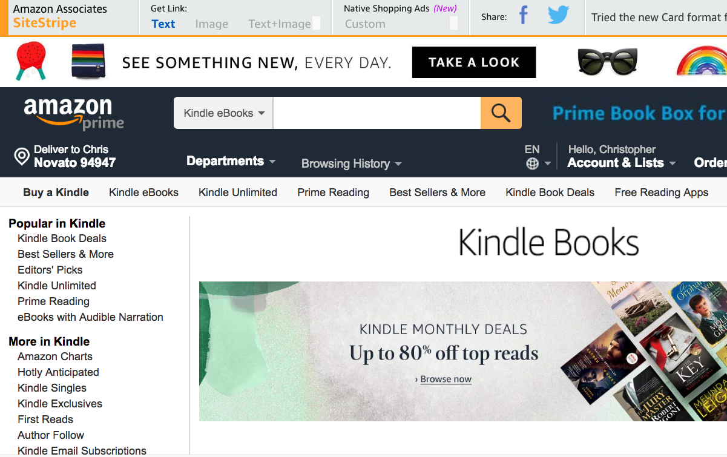
Select a book

Slide 48
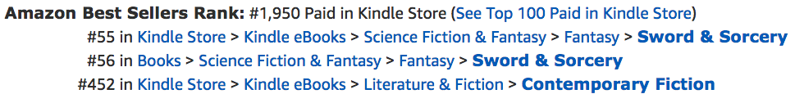
Find its rank

Slide 49
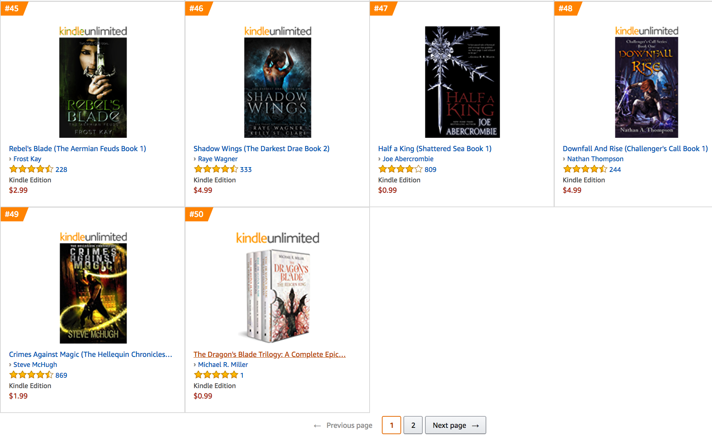
Repeat for
#20 and #100

Slide 50
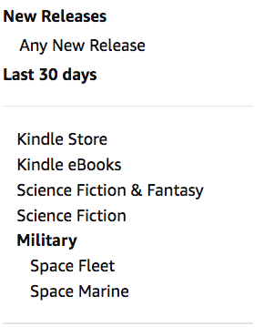
Check new releases

Slide 51
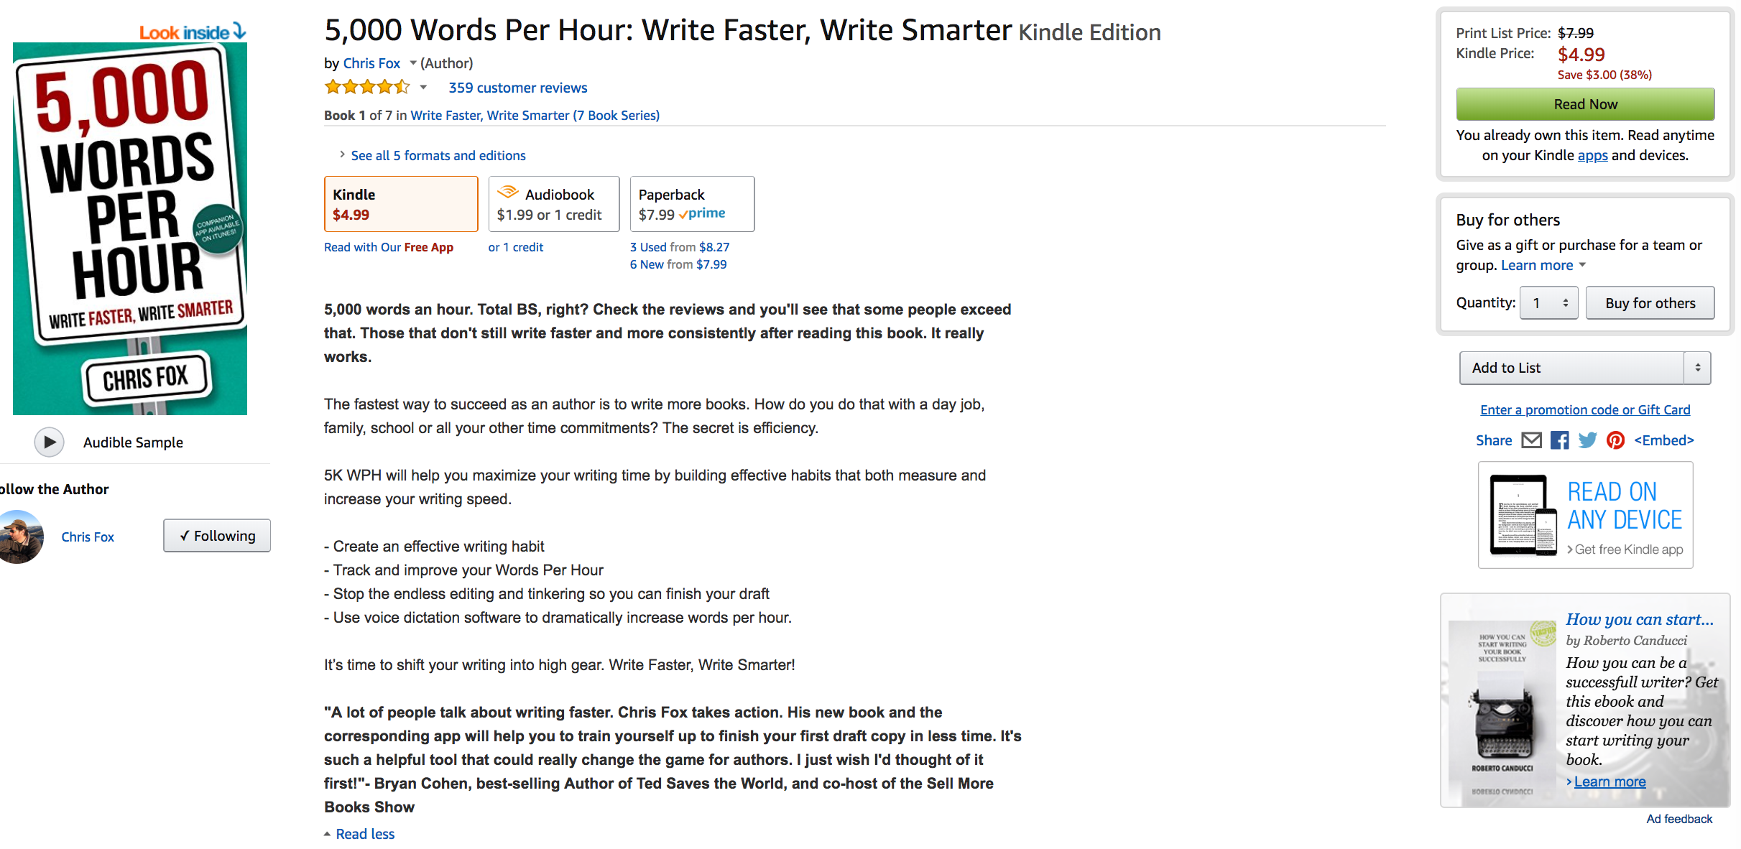
Study the top book

Slide 52
Mining Reviews

Slide 53
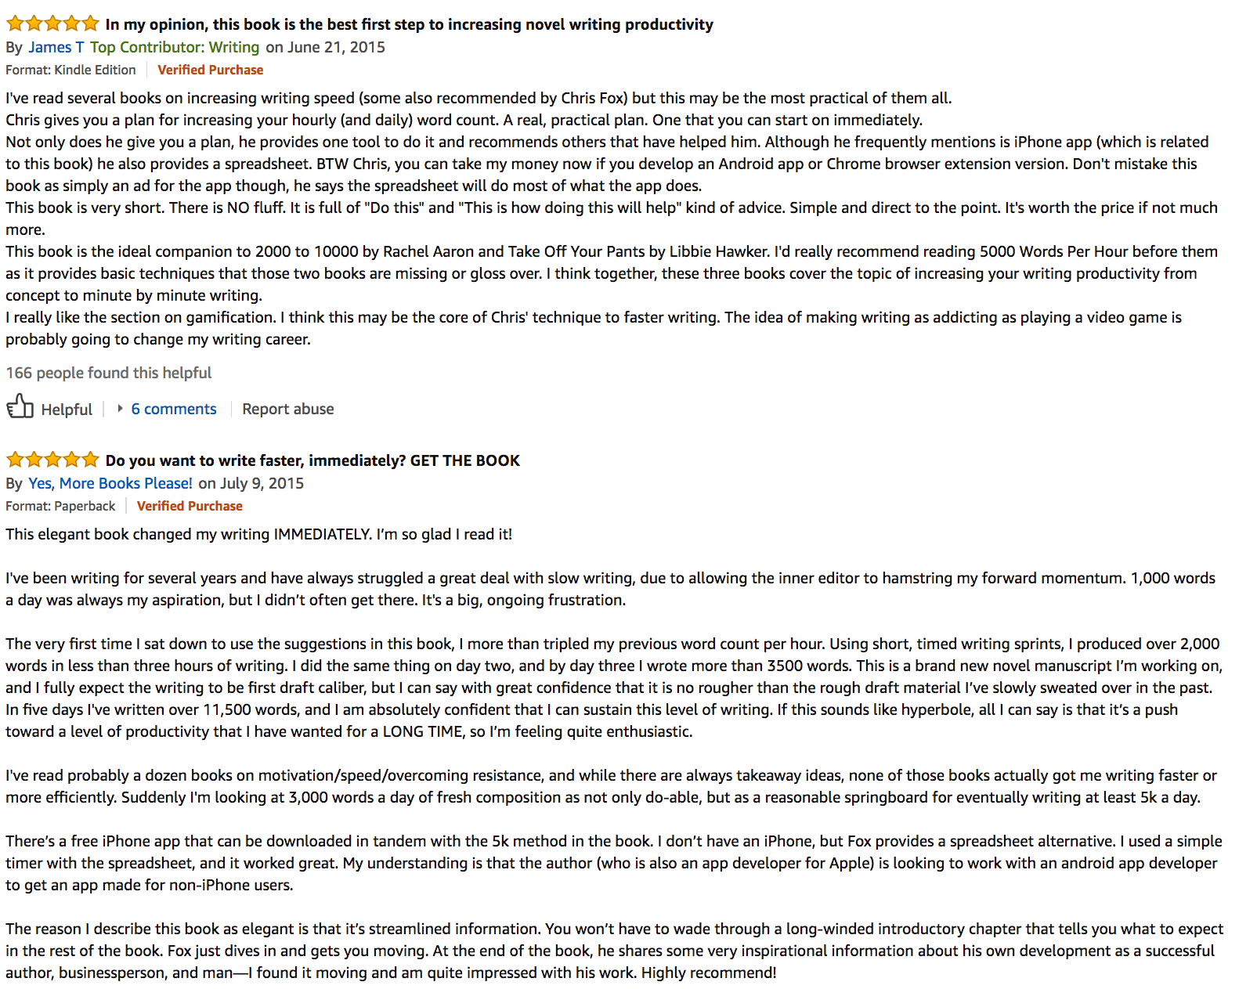
Good

Slide 54
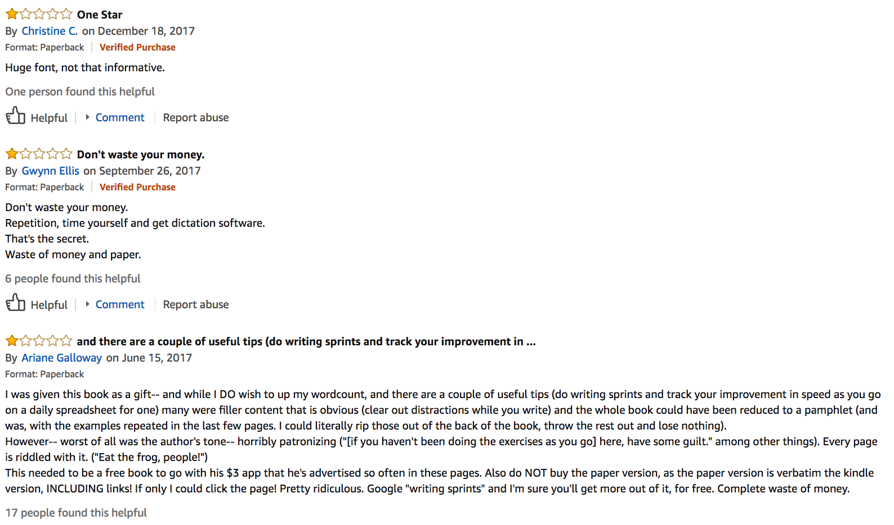
bad

Slide 55
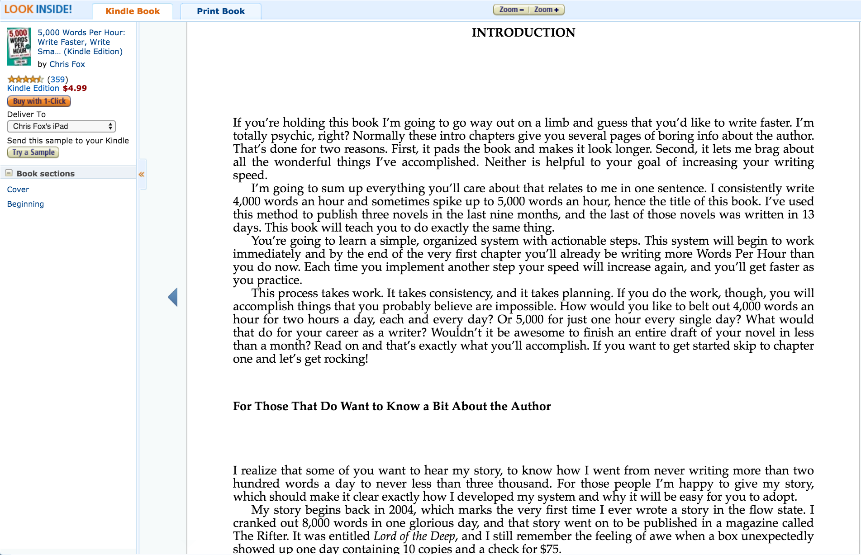
Critically Read the first 5,000 words

Slide 56
Run your inner critic
How long is the book?
What is the emotional payoff at the end?
What tropes and conventions did you notice?
What problems did you encounter?
What was the pacing like?
What story structure did the author use?

Slide 57
Read, Repeat

Slide 58
Total immersion

Slide 59
Predict trends

Slide 60
Space fantasy

Slide 61
Questions so far?

Slide 62
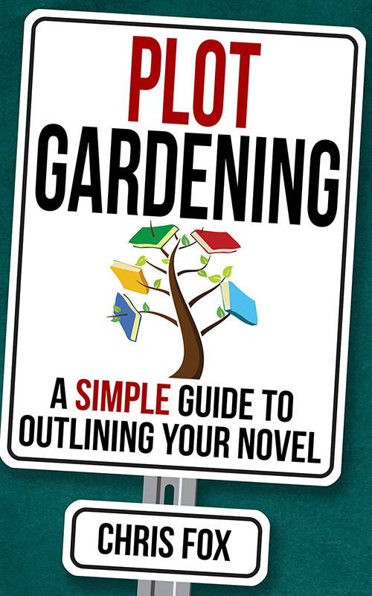
Crafting the tale
Part three

Slide 63
Pick a Platform

Slide 64
Option #1
Word or Pages

Slide 65
Option #2
Scrivener

Slide 66

Tropes

Slide 67
Trojan Prisoner

Slide 68
Genre
Conventions

Slide 69
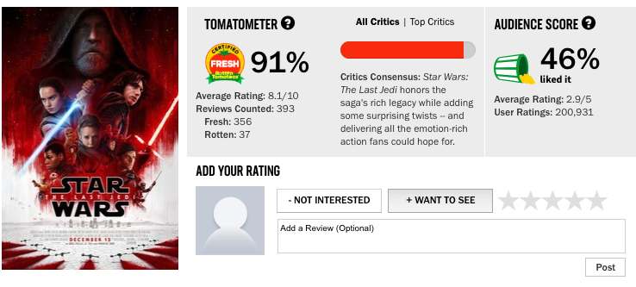
What happens when you break conventions?

Slide 70
tone

Slide 71
Themes

Slide 72
Same tone, different themes

Slide 73
Questions so far?

Slide 74
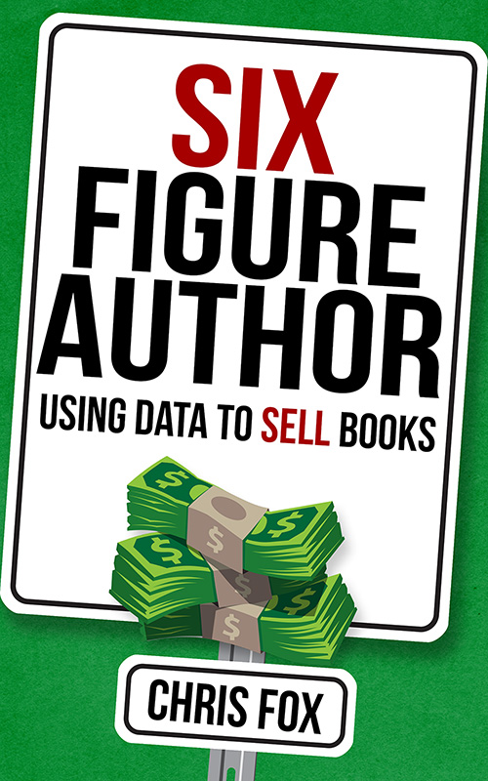
Selling Your Book
Part four

Slide 75
Passive marketing
Title
Cover
Blurb
Website
Newsletter
Videos
Social media

Slide 76
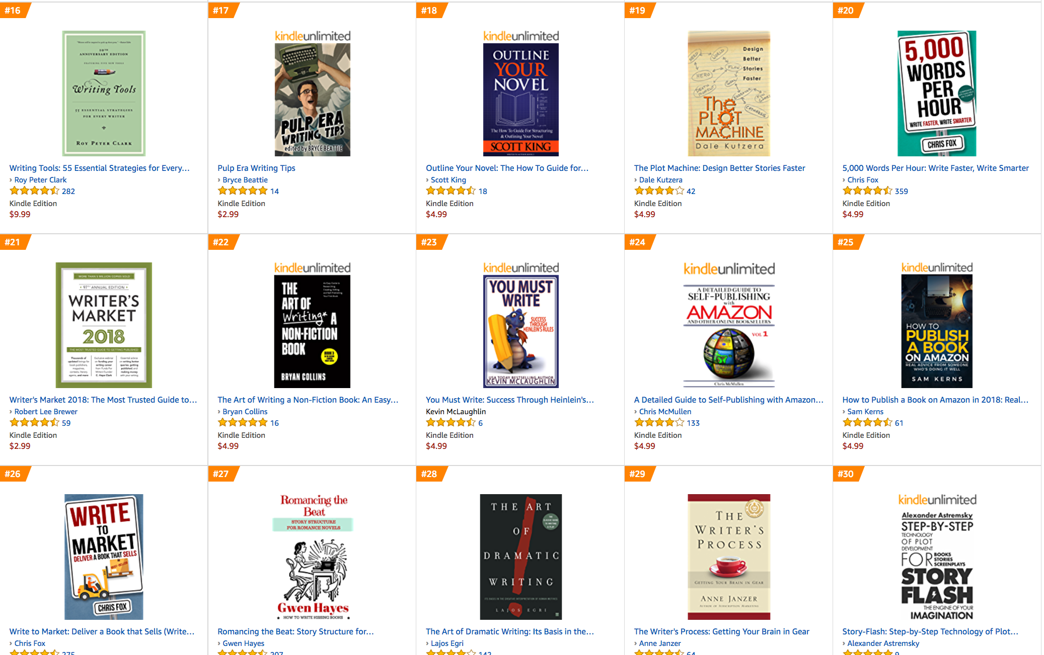
Reader eye flow

Slide 77
The Power of
data science

Slide 78
‘zon bot

Slide 79
The cliffs of insanity
30
60
90

Slide 80
Cover design
basics

Slide 81
One or two elements
High contrast

Slide 82
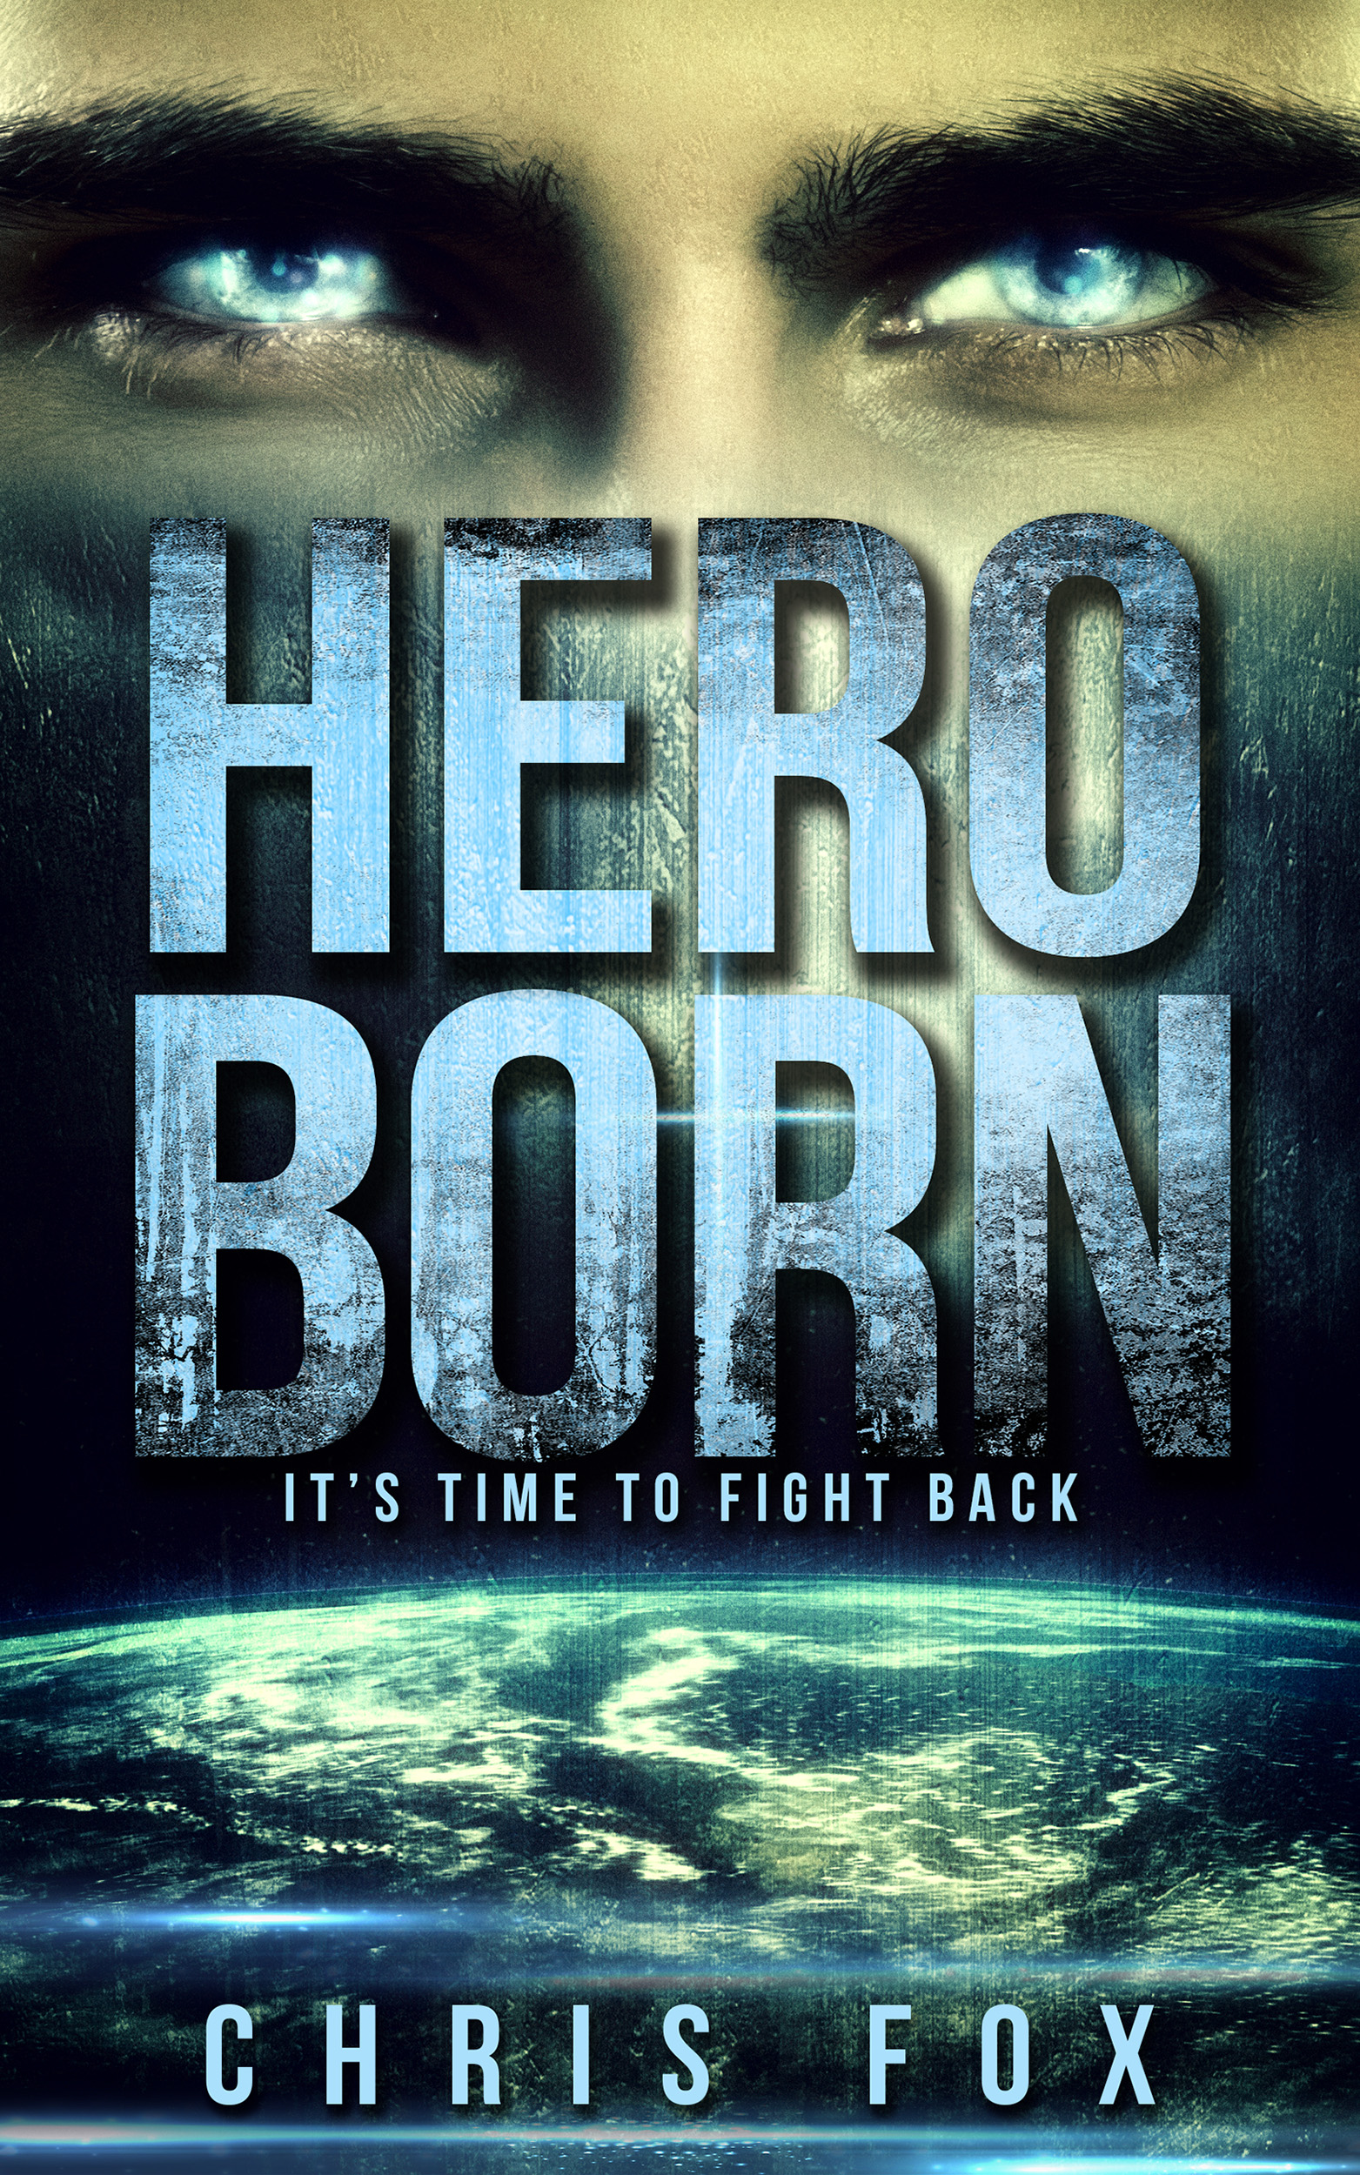
What not to do

Slide 83

What not to do II

Slide 84
Crafting a
perfect Title

Slide 85
Open
loops

Slide 86
Writing tagline
“In Space No One Can Hear You Scream.” — Alien
“A Tale of Murder, Lust, Greed,
Revenge, and Seafood.” — A Fish Called Wanda
“Be afraid. Be very afraid.”— The Fly

Slide 87
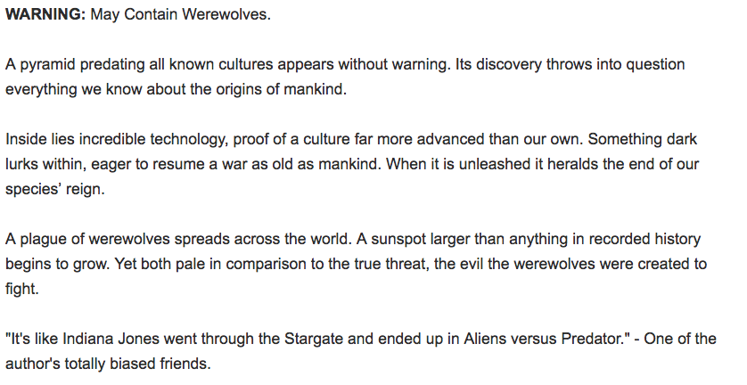
Writing Blurbs

Slide 88
Advanced stuff
Part five

Slide 89
Keywords

Slide 90
Categories

Slide 91
Also bought

Slide 92
Email Management

Slide 93
Prime Reading & Kindle first

Slide 94
Setting up a
Reader magnet

Slide 95
Bookfunnel

Slide 96
Book Report

Slide 97
Targeted advertising

Slide 98
Author networking

Slide 99
Rapid releases

